Slide 2
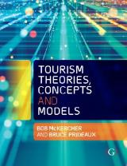

Chapter 9: Tourism as a Complex System

Slide 3
Learning Objectives
Describe why existing lifecycle models are deficient
Appreciate that tourism, by its very nature, is inherently volatile
Explain how and why tourism functions in a nonlinear manner
Explain the key features of a complex system.

Slide 4
Why existing models do not work
They are selective as to which elements they include and therefore which they exclude
Focus narrowly on selected destination variables and argue that simple cause and effect relationships exist between these variables
Propose a reductionist approach to tourism, where one could understand how it works by disaggregating it into its component parts, identifying the relationships between parts and then reaggregating it
Fail to reflect the dynamic nature of tourism, where hundreds or thousands of businesses, depending on the size of the destination, enter into and exit the marketplace, change ownership or reposition themselves radically each year
The tourism system can be seen as an open system subject to constant dynamic interactions with a whole series of internal and external agents

Slide 5
Unanswered Questions
How do small initial changes in tourism conditions lead to the popularity of certain destinations?
Are the positive feedback mechanism and increasing returns the norm in the tourism sector or does the system stabilise into the stage of saturation?
Why is it that certain destinations attract a particular type of visitor consistently?
What are the dynamics of maintaining sustainable development?

Slide 6
Fluctuations and instability are the norm and not the exception
Most models work on negative feedback and assume stability is the norm
But, from time to time apparently stable systems are thrown into a period of tremendous instability that rattle them to their core only to re-emerge in a different shape, stronger and more resilient
Outliers are often precursors of change
Existing models cannot accommodate the ongoing turbulence that is inherent even in mature, stable tourism communities
Do not explain well the inherent resilience of tourism systems

Slide 7
Tourism as a non-linear system
Non-linear systems
Cartesian-Newtonian systems
Many systems operate in a complex, non-linear, non-probabilistic, non-deterministic and dynamic systems manner and not as a machine
Likened to living systems where a vast number of elements form an array of rich, subtle, complex and varied relationships
Destinations act as complex systems with numerous interactions between the sectors operating within destinations and multiple stakeholders with varying and conflicting interests
Systems as machines
To understand how a machine works, break it into its component parts, understand how each part works and how they fit together
Machines work in a predictable manner, where a certain input produces the same output time and time again
Failure to understand how a system works is due to lack of information and if enough information can be gathered, then any system can be understood fully
Source: Faulkner and Russell 1997

Slide 8
Nature of complex systems
Nondeterminism – it is impossible to anticipate precisely the behaviour of such a system even knowing the function of all of its elements
Presence of feedback cycles both positive and negative that influence its overall behaviour
Distributed nature where many properties and functions cannot be precisely localized for in many cases there are redundancies and overlaps
Emergence and self organization where the system exhibits emergent properties that are not directly identifiable or predictable from the knowledge of single components
Limited decomposability where the dynamic structure of the system has to be studied as a whole
Self similarity whereby the system will look like itself at different scales if magnified or made smaller.
Source: Scott, Baggio and Cooper (2008)

Slide 9
Phase shift and edge of chaos
From time to time otherwise stable systems receive such profound shocks that they are shifted from one state to another
While individuals within the system may be adversely affected by abrupt change, the system as a whole will continue to operate
Chaotic systems shift abruptly from one state to another, rather than evolving slowly between the two states.
Systems have adaptive ability – even though individual elements may be adversely affected

Slide 10
Bifurcation
Bifurcation –literally, a “fork in the road” and was initially ‘an abrupt change in the long-term behaviour of a system’
Connected to phase-shift in that they move out of the linear realm and instability begins and nonlinearity sets in
As one gets close to the bifurcation points, the values of fluctuations increase dramatically. This leads to the butterfly effect in which a small change can lead to a significant change in the system

Slide 11
Butterfly Effect
“Sensitivity to initial conditions”
Small and apparently insignificant changes can produce large variations in the long term behaviour of a system
For want of a nail the shoe was lost.
For want of a shoe the horse was lost.
For want of a horse the rider was lost.
For want of a rider the message was lost.
For want of a message the battle was lost.
For want of a battle the kingdom was lost.
And all for the want of a horseshoe nail.

Slide 12

Lock in effect
(Positive feedback loop)
Inertia within a system is common, whereby an accident of history produces such a strong network of mutually reinforcing relationships
Computer keyboard.

Slide 13
Strange attractor
A common vision, sense of meaning, strategy or value system that drives people to achieve a common goal
System will manage itself, often in an unknowing manner, towards a common goal
In complexity theory, the system tends to work in a seemingly random and complex way, in that each element in the system may seem to act in an independent manner, but the system as a whole does not pass certain boundaries
Chaos/complexity is evolutionary

Slide 14
Self organising
Inherently unstable and constantly changing
Objective of optimizing the available resources
  Renders the system better suited to face external or internal burdens
2 features:
  Ability to sometimes withstand large shocks without apparently modifying itself or its evolutionary path
  Seemingly irrelevant event can produce an avalanche which completely destroys it

Slide 15
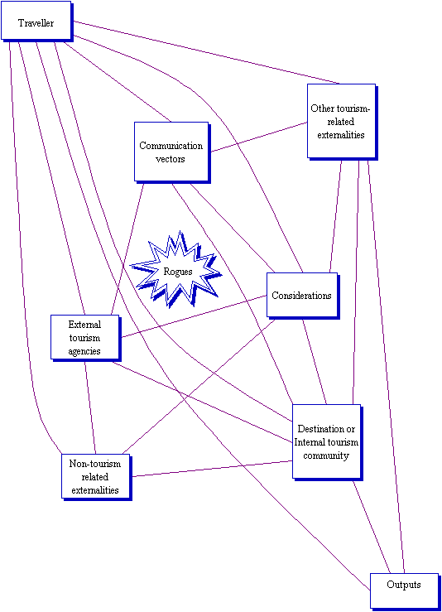
A complex tourism system
The Traveller, who is the essential player in tourism
The Communication vectors used to connect the traveller to the destination
The Considerations or factors that influence the effectiveness of the Communication vectors used
The Destination or Internal tourism community
External tourism agencies (public and private sector) that try to influence tourism
Other tourism-related externalities, such as alternative tourism destinations
Non-tourism related externalities, or macro-environmental forces
Outputs both desired and undesired, and
Rogues or Chaos makers
Source: McKercher 1999

